Slide 1
Midterm Contest Presentation
Student id: 311512015
Name: 謝元碩

Slide 2
Outline
Contribution
Difference from others

Slide 3
Contribution - initial pose finding
Problem:
Yaw of initial pose in every contest is a constant value.
It takes lots of times to find the yaw in the beginning.
Design:
When we find the yaw for the first time, just give this value to yaw directly.
It saves times for running all the simulations.

Slide 4
Contribution – IMU sensor
Problem:
In the contest 2&3, the environments and driving paths are more complex than those in contest 1.
Environments: trees, cars in the parking lot, other driving cars on the road.
Driving paths: turn left or right, first drive backward and then speed up.
Localization error will become larger by times easily

Slide 5
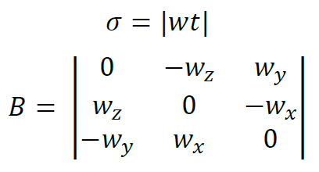
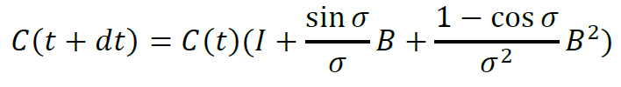
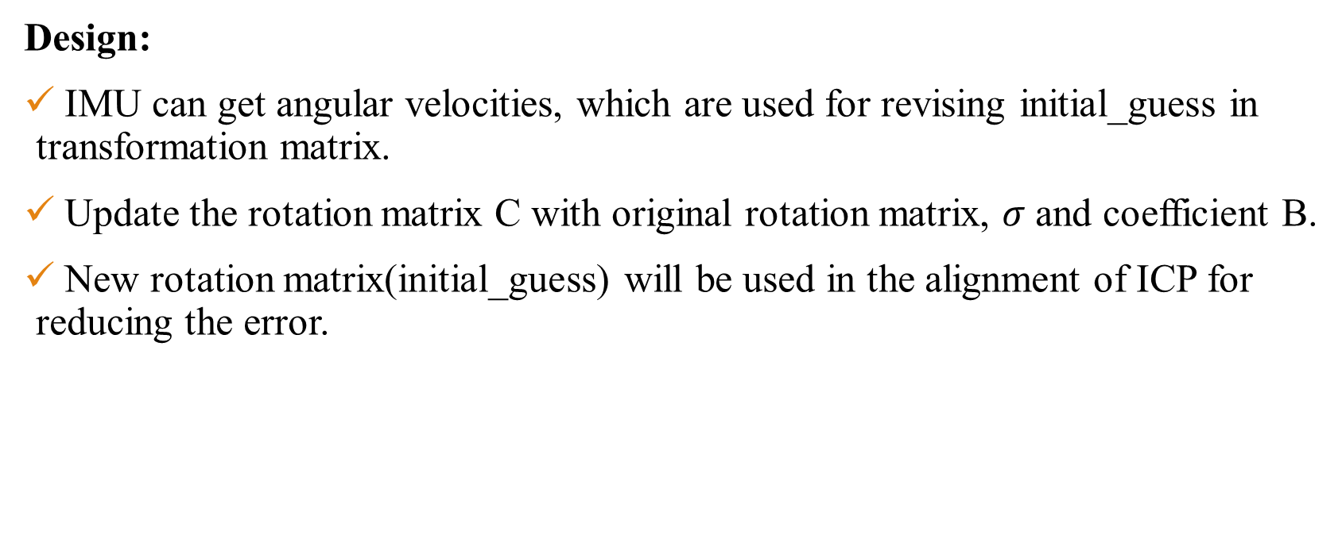
Contribution – IMU sensor
Design:
IMU can get angular velocities, which are used for revising initial_guess in transformation matrix.
Update the rotation matrix C with original rotation matrix, $σ$ and coefficient B.
New rotation matrix(initial_guess) will be used in the alignment of ICP for reducing the error.
Notes:
原本的initial_guess只有ICP在更新(使用前一次轉移矩陣的值)

Slide 6
Contribution – IMU sensor
Test & Difficulty:
The frequency of callback function is different from that of lidar
→ different update frequencies of initial_guess
In contest 2, it has slower update frequency but has better result.
In contest 3, it has normal update frequency, but the localization is just improved a little.
Compare results between having IMU and no having IMU.

Slide 7
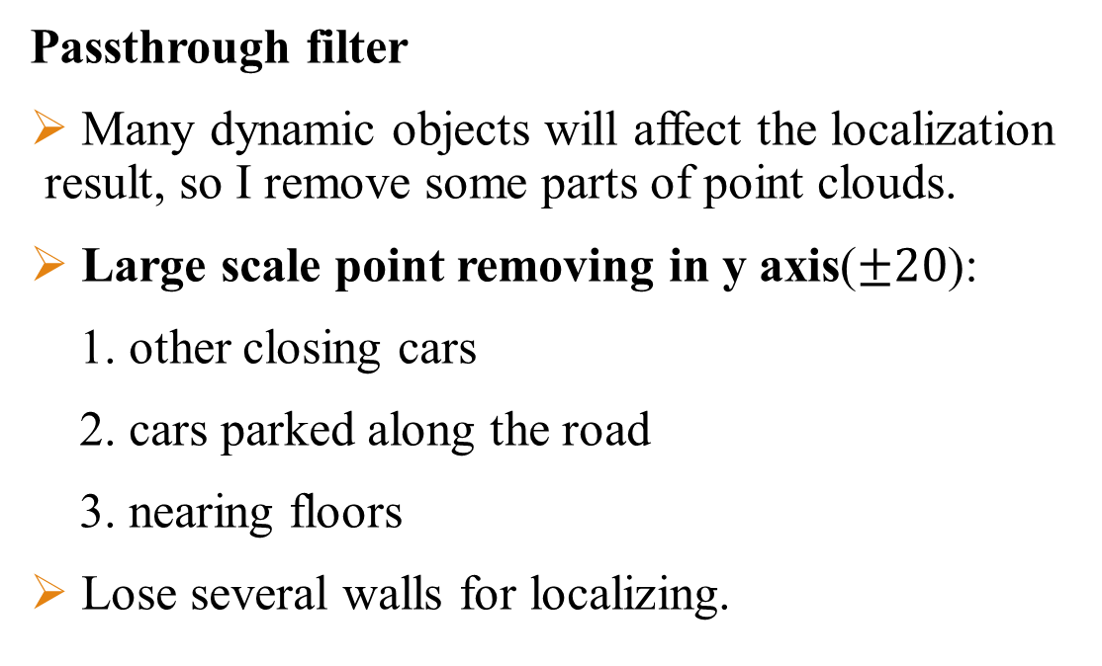
Difference from others
Passthrough filter
Many dynamic objects will affect the localization result, so I remove some parts of point clouds.
Large scale point removing in y axis($±20$):
1. other closing cars
2. cars parked along the road
3. nearing floors
Lose several walls for localizing.

Slide 8
Difference from others
Passthrough filter
Point storing in z axis(-5~8):
1. remove outliers
Why it still has good localization when removing large scale points in y axis:
1. It just needs a little points to implement the localization.
2. Farther points are still alive and usable.

Slide 9
Difference from others
Contest 1
Just modify the parameters of ICP algorithm.
Contest 3
Compared to contest 2, I just comment y axis passthrough filter, because the environment is simpler than that of contest 2.
It performs well when I remove y axis passthrough filter.

Slide 10
Thank you

